Slide 1
Spring workshop
Karthikeyan Bollu Ganesh
Michael Inden
Asmiq Academy

Slide 2
Contents
Introduction
Spring Framework I
Spring Architecture
Dependency Injection
DI/IoC in Spring
XML Configuration
Java Configuration
Bean Lifecycle
Bean Scopes
Exercises
Spring Framework II
Web-MVC
Exercises
Spring Boot I
Introduction
Spring Initializr
REST Service with Spring-Boot
Spring Dev-tools Demo
Testing
Exercises
Annotation Configuration

Slide 3
Introduction

Slide 4

Father of Spring

Slide 5
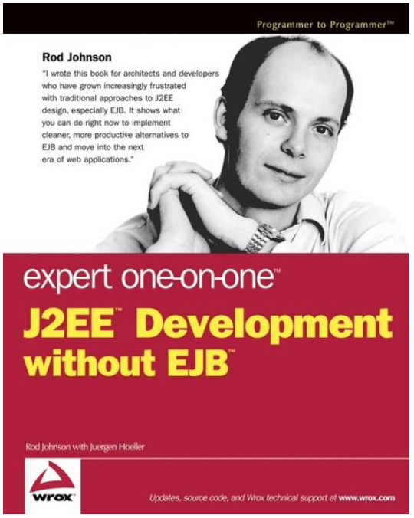
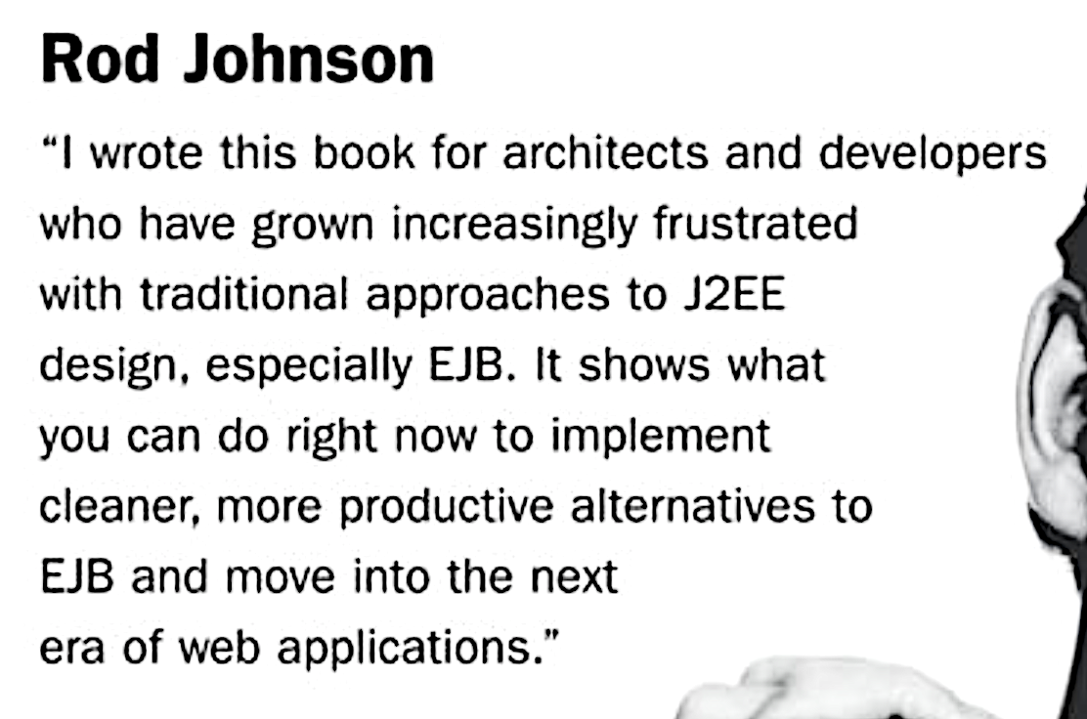
Spring‘s birth

Slide 6




Spring‘s birth
V 0.9
Notes:
Rod Johnson wrote this book on 2002 with describes the complexities of the EJB and he wrote all the infrastructure code for the dependency injection in the package com.interface21. Later Jürgen Höller requested him to create a open source framework based on this infrastructure code, which gave birth to the Spring framework.

Slide 7




Spring‘s growth
2003
2006
2009
2013
2017
1.0
2.0
3.0
4.0
5.0

Slide 8




Spring company‘s growth
2008
2009
2002
2013
Notes:
In April 2013 VMware, and its parent company EMC Corporation, formally created a joint venture (with GE) called Pivotal Software.

Slide 9
Spring - Benefits
Light weight
Just POJO – need not implement/extend any framework interfaces/classes
Modular
Include just the needed module to use the needed functionality.
For DI just include spring-context
Non-intrusive
domain logic code generally has no dependencies on the framework itself
Notes:
Light weight/ Non-intrusive: POJO means Plain Old Java Object. It refers to a Java object (instance of definition) that isn't bogged down by framework extensions. -> https://spring.io/understanding/POJO
Modular: We do not all of the spring‘s modules to create an app. Forexample to use the DI functionality in our web-app, we can just add the spring-context module.

Slide 10





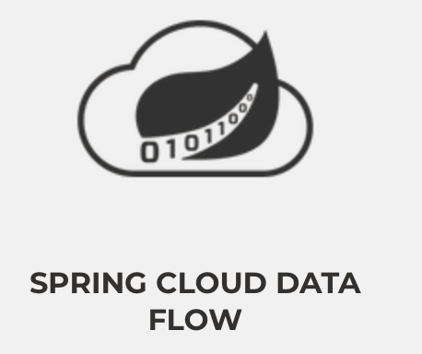


Major Spring Projects

Slide 11


Spring Framework - JDK Baseline
Version | JDK 6 | JDK 7 | JDK 8 | JDK 9 | JDK 10 | JDK 11 | JDK 12
4.3.x
5.0.x
5.1.x

Slide 12
Spring Framework 5 + JDK 9 Module
Does Spring Framework 5 work with the new Java 9 module system?
Yes, Spring Framework 5 ships with automatic module name entries in the manifests of our Spring Framework 5 jars. The public API surface of the Spring libraries remains unchanged.

Slide 13
Spring Framework I

Slide 14
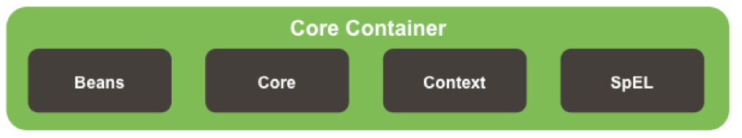
Spring Architecture

Slide 15
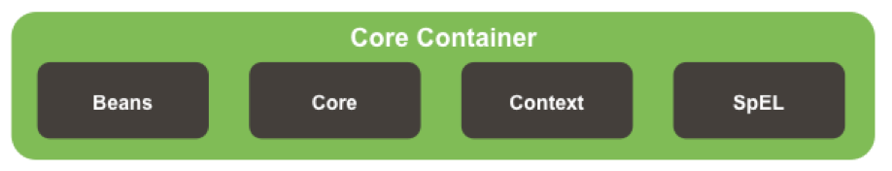



Spring Core Container Details

Slide 16
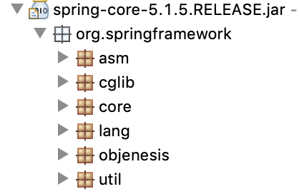
Core Module
Notes:
ASM – bytecode Manipulation and Analysis Framework
Cglib – bytecode generation library
Core – contains classes for exception-handling and for detecting the versions etc.
Lang – classes to mark the version info
Util – classes for logging configs, string manipulations etc.

Slide 17
Beans Module
Contains necessary classes and interfaces for the manipulation of the java beans
Defines most important interface like BeanFactory for Dependency Injection.
Includes utility functions for checking property types, copying bean properties, instantiating java beans.

Slide 18
Context and SpEL Modules
Context
Defines the interface ApplicationContext, which extends BeanFactory
Spring Expression Language
“Language to query and manipulate the object graph at runtime.“
#{object.property}
#{object.subobject.property}

Slide 19
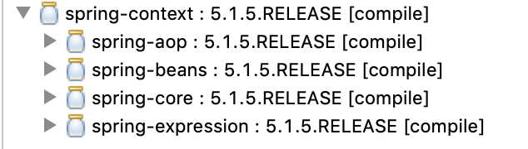
Core Container Module

Slide 20
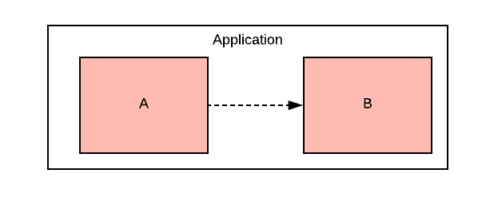
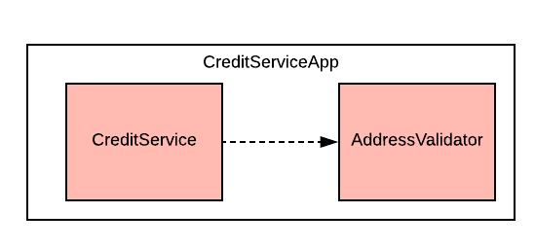
Dependency
Notes:
To provide the creditservice functionality the app depends on the validation of the address.
In crude form:
When an object A needs/uses another object B to provide a functionality of an application, then Object A is dependent on Object B

Slide 21
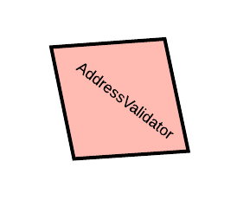
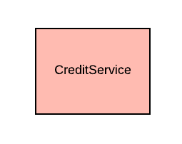


Slide 22
Dependency Injection
The process of introducing the dependency to the dependent object is called dependency injection

Slide 23
Dependency Injection
public class CreditServiceApp {
public static void main(String[] args) {
var addressValidator = new AddressValidator();
var creditService = new CreditService(addressValidator);
creditService.dispatchCredit();
}
}

Slide 24

Manual Dependency Injection
public class CreditServiceApp {
public static void main(String[] args) {
var addressValidator = new AddressValidator();
var creditService = new CreditService(addressValidator);
creditService.dispatchCredit();
}
}
Manual DI

Slide 25

What if ?
CreditService -> SmsService -> MobileSubscriptionService - > PaymentService
CreditService -> PaymentService -> InvoiceService -> InvoiceSchedulingService
MobileSubscriptionService -> GatewayService -> InvoiceService -> AddressService

Slide 26
Manual DI Problems
A depender knows the internal details of the dependee
Not easily testable
Tight Coupling
Hinders the code readability
Notes:
The more the dependencies, the more the modifications in code
A depender knows the internal details of the dependee
Example - SmsService -> MobileSubscriptionService
In this case -> SmsService has to know how to create MobileSubscriptionService
Not easily testable
Without resolving all the dependencies it is almost impossible to test the NotificationService.
Tight Coupling
Changes in the construction logic of the dependee results in the changes in the construction of the depender.
Hinders the code readability
The instantiation logic are scattered, which prevents the smooth flow of understanding the actual functionality

Slide 27

Solution for manual DI Problems
having an agent/factory/framework/x
to instantiate the dependee objects
resolve the dependencies

Slide 28
IoC / DI
The process
of letting out our control in the instantiation of dependent objects and configuring the object graph is Inversion of Control (IoC)
of resolving the dependencies is called Dependency Injection (DI)

Slide 29

Dependency Injection in Spring

Slide 30



Spring Bean
Plain Old Java Object (POJO) which is/will be managed by the Spring is called Spring Bean.
SimpleCar Bean
Spring
SimpleCar

Slide 31
IoC Container
Is also an object
manages other objects
enables Dependecy Injection
builds Object Graphs

Slide 32
IoC Container
D
C
Spring
A
B

Slide 33

IoC container in Spring
BeanFactory
low-level interface
defines the basic and core functionality of the IoC
ApplicationContext
extends BeanFactory
included in the module spring-context

Slide 34
IoC configuration metadata
The information needed to configure the IoC Container is Configuration Metadata

Slide 35
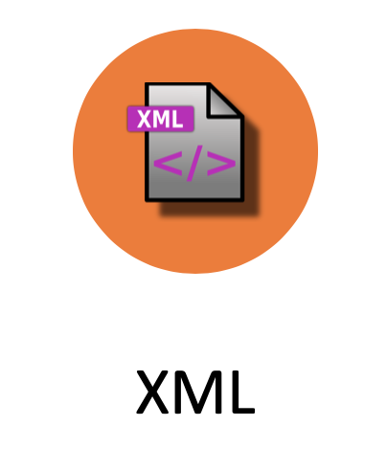

Configuration metadata types
XML
Annotation
Java

Slide 36
XML Configuration
<?xml version="1.0" encoding="UTF-8"?>
<beans xmlns="http://www.springframework.org/schema/beans"
xmlns:xsi="http://www.w3.org/2001/XMLSchema-instance"
xsi:schemaLocation="http://www.springframework.org/schema/beans http://www.springframework.org/schema/beans/spring-beans.xsd">
<bean id="<bean_id>" class="<class>">
<property name=""></property>
<property name=""></property>
</bean>
</beans>

Slide 37
Java Configuration
@Configuration
public class MyConfig{
@Bean
public A a(){
//return A
}
@Bean
public B b(){
// return B
}
}

Slide 38
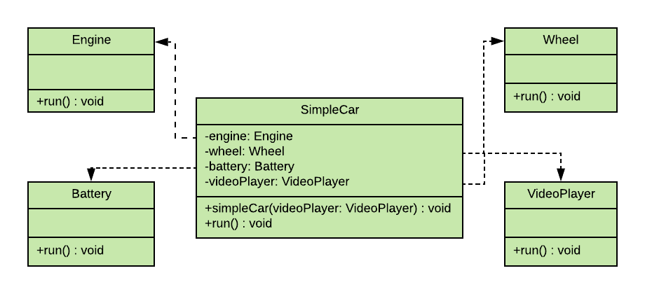
XML Configuration

Slide 39
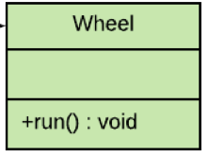
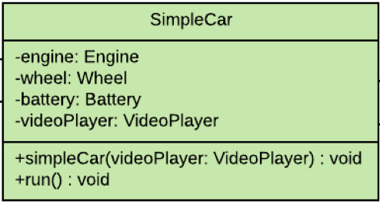
<?xml version="1.0" encoding="UTF-8"?>
<beans xmlns="http://www.springframework.org/schema/beans"
xmlns:xsi="http://www.w3.org/2001/XMLSchema-instance"
xsi:schemaLocation="http://www.springframework.org/schema/beans http://www.springframework.org/schema/beans/spring-beans.xsd">
<bean id="wheel" class="ch.karthi.Wheel"/>
<bean id="engine" class="ch.karthi.Engine"/>
<bean id="battery" class="ch.karthi.Battery"/>
<bean id="videoPlayer" class="ch.karthi.VideoPlayer"/>
<bean id="simpleCar" class="ch.karthi.SimpleCar">
<constructor-arg ref="videoPlayer" name="videoPlayer"/>
<property name="engine" ref="engine" />
<property name="wheel" ref="wheel"/>
<property name="battery" ref="battery"/>
</bean>
</beans>

Slide 40
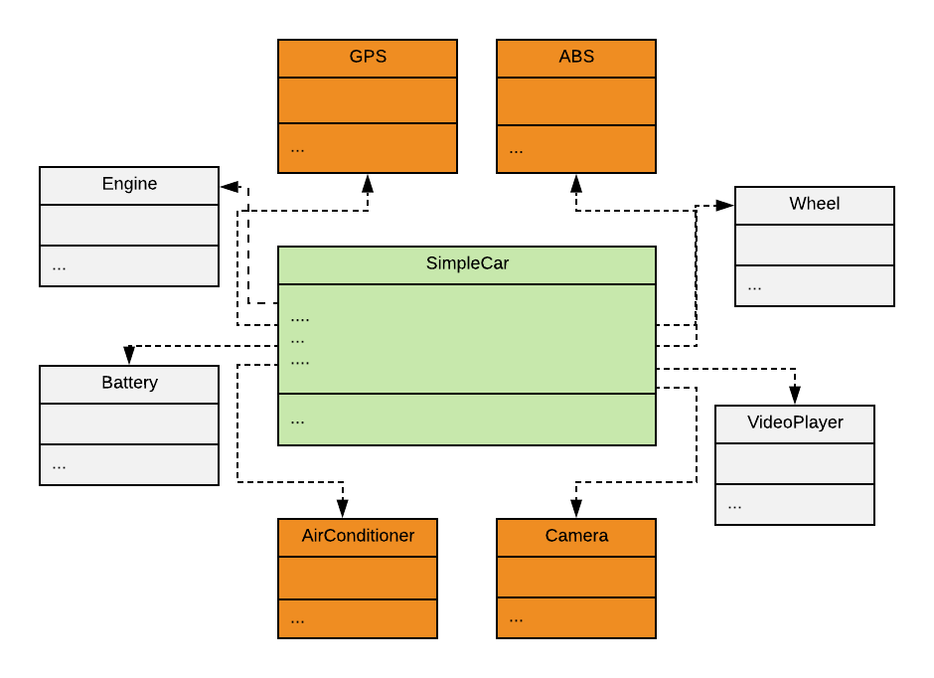
XML Configuration

Slide 41
<?xml version="1.0" encoding="UTF-8"?>
<beans xmlns="http://www.springframework.org/schema/beans"
xmlns:xsi="http://www.w3.org/2001/XMLSchema-instance"
xsi:schemaLocation="http://www.springframework.org/schema/beans http://www.springframework.org/schema/beans/spring-beans.xsd">
<bean id="wheel" class="ch.karthi.Wheel"/>
<bean id="engine" class="ch.karthi.Engine"/>
<bean id="battery" class="ch.karthi.Battery"/>
<bean id="videoPlayer" class="ch.karthi.VideoPlayer"/>
<bean id="gps" class="ch.karthi.GPS"/>
<bean id="camera" class="ch.karthi.Camera"/>
<bean id= … />
...
<bean id="simpleCar" class="ch.karthi.SimpleCar">
<constructor-arg ref="videoPlayer" name="videoPlayer"/>
<property name="engine" ref="engine" />
<property name="wheel" ref="wheel"/>
<property name="battery" ref="battery"/>
</bean>
</beans>

Slide 42
<?xml version="1.0" encoding="UTF-8"?>
<beans xmlns="http://www.springframework.org/schema/beans"
xmlns:xsi="http://www.w3.org/2001/XMLSchema-instance"
xsi:schemaLocation="http://www.springframework.org/schema/beans http://www.springframework.org/schema/beans/spring-beans.xsd">
Karthi : Hey Spring! Could you please do the bean definitions for me ?
Spring : Yes with pleasure. For that I need some infos too.
<bean id="simpleCar" class="ch.karthi.SimpleCar">
<constructor-arg ref="videoPlayer" name="videoPlayer"/>
<property name="engine" ref="engine" />
<property name="wheel" ref="wheel"/>
<property name="battery" ref="battery"/>
</bean>
</beans>

Slide 43
<?xml version="1.0" encoding="UTF-8"?>
<beans xmlns="http://www.springframework.org/schema/beans"
xmlns:xsi="http://www.w3.org/2001/XMLSchema-instance"
xsi:schemaLocation=http://www.springframework.org/schema/beans http://www.springframework.org/schema/beans/spring-beans.xsd
http://www.springframework.org/schema/context http://www.springframework.org/schema/context/spring-context.xsd">
<bean id="simpleCar" class="ch.karthi.SimpleCar">
<constructor-arg ref="videoPlayer" name="videoPlayer"/>
<property name="engine" ref="engine" />
<property name="wheel" ref="wheel"/>
<property name="battery" ref="battery"/>
</bean>
</beans>

Slide 44

Annotation configuration
@Component
public class Wheel {
Stereotype Annotations
@Component
public class SimpleCar {
@Component
public class Engine {
@Component
public class VideoPlayer {
@Component
public class Battery {

Slide 45
Stereotype Annotations
@Component
@Service
@Repository
@Controller
@RestController
@ControllerAdvice
@Configuration

Slide 46
<?xml version="1.0" encoding="UTF-8"?>
<beans xmlns="http://www.springframework.org/schema/beans"
xmlns:xsi="http://www.w3.org/2001/XMLSchema-instance"
xsi:schemaLocation=http://www.springframework.org/schema/beans http://www.springframework.org/schema/beans/spring-beans.xsd
http://www.springframework.org/schema/context http://www.springframework.org/schema/context/spring-context.xsd">
Karthi : Hey Spring! is it possible to configure these dependencies in java class itself?
Spring : Yes with pleasure. see @Autowired
<bean id="simpleCar" class="ch.karthi.SimpleCar">
<constructor-arg ref="videoPlayer" name="videoPlayer"/>
<property name="engine" ref="engine" />
<property name="wheel" ref="wheel"/>
<property name="battery" ref="battery"/>
</bean>
</beans>

Slide 47
@Autowired
@Component
public class SimpleCar {
@Autowired
private Engine engine;
@Autowired
private Wheel wheel;
@Autowired
private VideoPlayer videoPlayer;
@Autowired
private Battery battery;
@Autowired
public SimpleCar(VideoPlayer videoPlayer) {
this.videoPlayer = videoPlayer;
}

Slide 48
<?xml version="1.0" encoding="UTF-8"?>
<beans xmlns="http://www.springframework.org/schema/beans"
xmlns:xsi="http://www.w3.org/2001/XMLSchema-instance"
xsi:schemaLocation=http://www.springframework.org/schema/beans http://www.springframework.org/schema/beans/spring-beans.xsd
http://www.springframework.org/schema/context http://www.springframework.org/schema/context/spring-context.xsd">
Karthi : Hey Spring! is it possible to configure everything in java class itself?
Spring : Yes with pleasure. Use @ComponentScan and remove this XML File ☺
</beans>

Slide 49
IoC Container Creation
var context = new ClassPathXmlApplicationContext("config.xml");
var simpleCar = context.getBean(SimpleCar.class);
// do something with the simpleCar

